Slide 1
Who is Our Audience?
By : KAIF SHAHEEM J

Slide 2
i) @shaheem
Importance of Target Audience
Defining Target Audience
Demographics and Psychographics
Understanding the Target Audience
Our Audience
Understanding Our Target Audience

Slide 3


Slide 4
“What group of People have the greatest desire to acquire the Outcome that our Solution provide?”
Absolutely everybody to specific group of people
02 @shaheem

Slide 5

Importance of Target Audience

Slide 6
“A target audience is a specific group of people most likely want or need what our brand offers”
The importance of target audience in marketing and branding isn’t something we can ever overstate.
Put simply, without the audience there is no brand.
The brand exists to serve the audience and it’s in their mind the brand is built
04 @shaheem

Slide 7


Slide 8
Through the Marketing a brand is born, it’s born from the idea of a visionary.
This person has identified a problem in the market that they can solve alternatively to some of the existing options available.
Maybe the idea was born by chance or maybe it was on the back of extensive research.
As the leader of your brand, you have an advantage because you can relate to the experiences of your target audience.
This understanding helps you connect with them on a deeper level.
06 @shaheem

Slide 9

Why Defining the Target Audience is so important?

Slide 10
Often a business idea is born from the experience of the problem
A person has a problem. They reflection the experience of that problem and how it could be better mitigated.
In this case, the target audience are people exactly like similar to the visionary who are likely to experience the same problem in the similar way.
08 @shaheem

Slide 11
Understanding the people who experience the problem you solve is without doubt one of the most critical task in the entire realm of branding
This Understanding is the key to bridging the gap between that audience and the solution your brand offers.
09 @shaheem

Slide 12

Demographics and Psychographics
Demographics and Psychographics are two usual suspects when it comes to defining your target audience.
“The importance of defining your target audience”, will list these two categorization tools as the secret weapon

Slide 13
Defining Your Target Audience With Demographics
Demographics is ultimate categorization tool, which focus on basic detail of the audience
If you start with your audience as “everybody”, demographics quickly filter out people who you’re not targeting.
if you’re selling women’s shoes then the “gender” demographic will quickly help you filter out men, narrowing your audience by half.
11 @shaheem

Slide 14
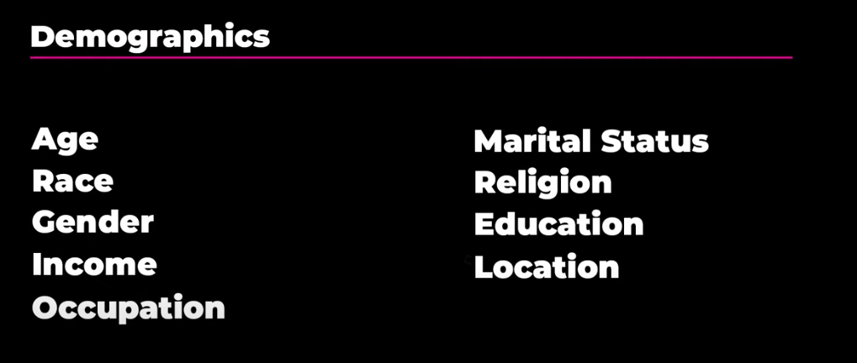

Slide 15
Defining Your Target Audience With Psychographics
Psychographics is another layer of categorization, which focus on behaviour of the the audience
While demographics helped you to filter out the least, psychographics help you to further refine your audience based on the behaviours.
If the shoes you were selling weren’t your average women’s shoe, but a climbing shoe, then psychographics will help you to categorize your audience based on this behaviour.
13 @shaheem

Slide 16


Slide 17
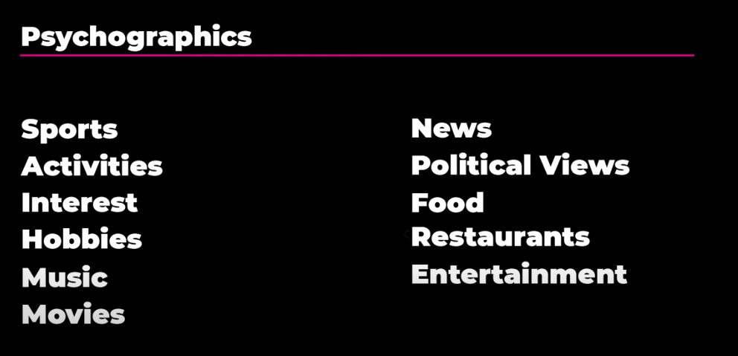

Slide 18
Understanding the Target Audience
Involves conducting thorough market research and analysis to gain insights into the characteristics, preferences, and needs of people who are the most likely to be interested in your product or service.
⇒ Define your Product or Service
⇒ Conduct market research
⇒ Identify Demographics
⇒ Analyse Psychographics
⇒ Use Analytical tools
⇒ Stay Updated
16 @shaheem

Slide 19
Who is Our Audience?
⇒ Traders
→ Individual Retail Traders
→ Active Traders
→ Institutional Traders
⇒ Investors
⇒ Financial Enthusiasts
⇒ Financial professionals
17 @shaheem

Slide 20
Understanding Our Target Audience
⇒ Define Our Product and Services
→ TREDGE
⇒ Conduct Market Research
→ Statista
→ Qualtrics
⇒ Demographics and Psychographics
⇒ Analytics through Web and Social Media
⇒ Stay Updated
18 @shaheem

Slide 21


Slide 22
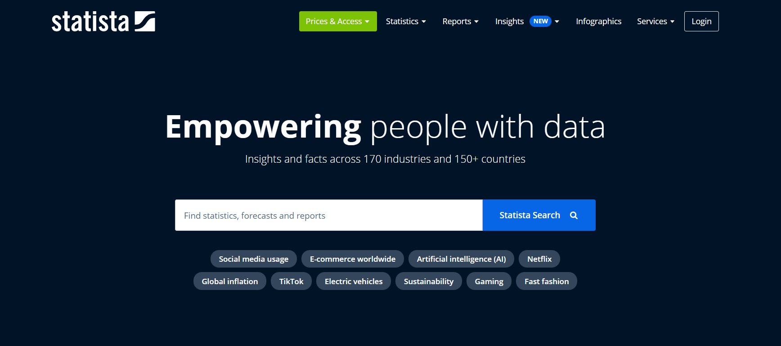

Slide 23


Slide 24
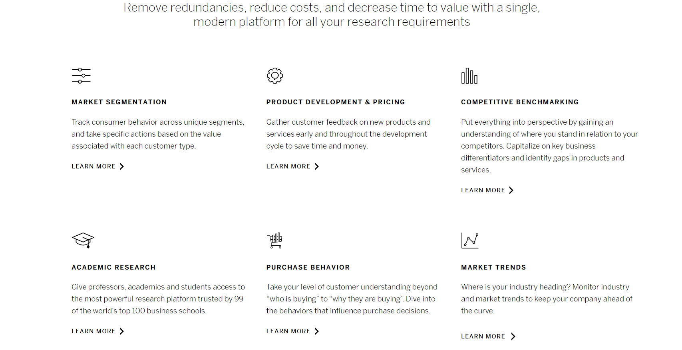

Slide 25
⇒ Demographics
→ Age
→ Gender
→ Geographic Locations
→ Trading Experiences
23 @shaheem

Slide 26
⇒ Psychographics
→ Trading Style
→ Risk Appetite
→ Trading Goals
→ Emotional Drivers
→ Knowledge and Experience
24 @shaheem

Slide 27
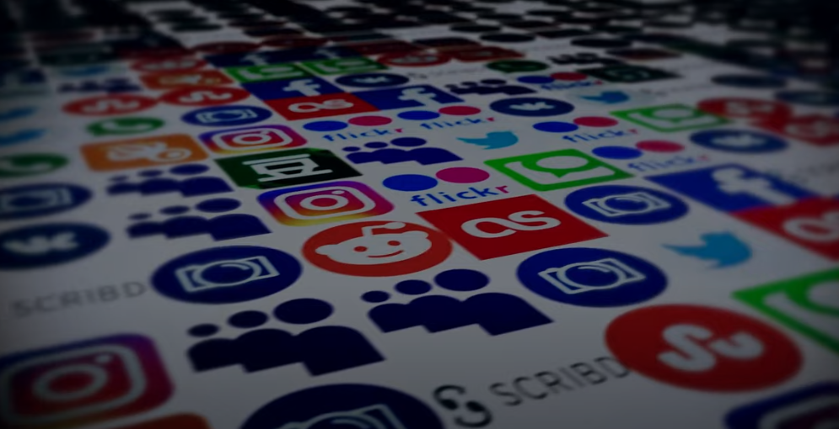
Analytics through Web and Social Media

Slide 28

⇒ Challenges increase the Emotional tension and the desire for an Outcome
Arm with our tools that they need to help them
27 @shaheem

Slide 29

⇒ Put your offer in front of the forum groups and anywhere of your audience
⇒ Survey your audience with providing offers
⇒ Asking Questions to your audience
⇒ Ratings
28 @shaheem

Slide 30
References
⇒ BrandMasterAcdemy.com
⇒ Betterbizworks.com
⇒ Wolterskluwer.com
29 @shaheem

Slide 31
These all are such ways to find our target audience, through these steps or procedures a product can be created as a brand.
Angel One client base jumps 44% in May, retail equity market share rises 4%
30 @shaheem

Slide 32
Thank You

